Slide 1





TachyHealth AI-based Healthcare Solutions
Riyadh - Dubai - Delaware
© Copyright 2018-2025 for TachyHealth. - All rights reserved

Slide 2




Proven Success
TachyHealth Traction in Numbers
$1.3B
Worth of claims processed
TachyHealth leverages AI, automation, and data science to enhance value-based healthcare. We optimize the medical journey with advanced systems for medical necessities, coding, analysis, and cost savings. Our deep technology solutions are best-in-class.
97%
Predictability of rejections and denials
250M+
Claims trained on our systems
3,850+
Embedded Medical guidelines
Notes:
Add to be updated

Slide 3






We're revolutionizing healthcare with our AI-powered platform, enhancing the end-to-end patient journey for a smarter, seamless experience
Fit for Purpose
Accuracy
High Performance
Predictability

Slide 4







AI Transformation For Healthcare Providers
For Healthcare Providers
Revolutionizing Healthcare with AI and Data Science with

Slide 5










End to end workflow
Assisting the medical team at the right moment
Streamline
Optimize
Analyze
Empower
Automate
Pre - Encounter
Encounter
Post - Encounter
360 Insights
Supported by

Slide 6



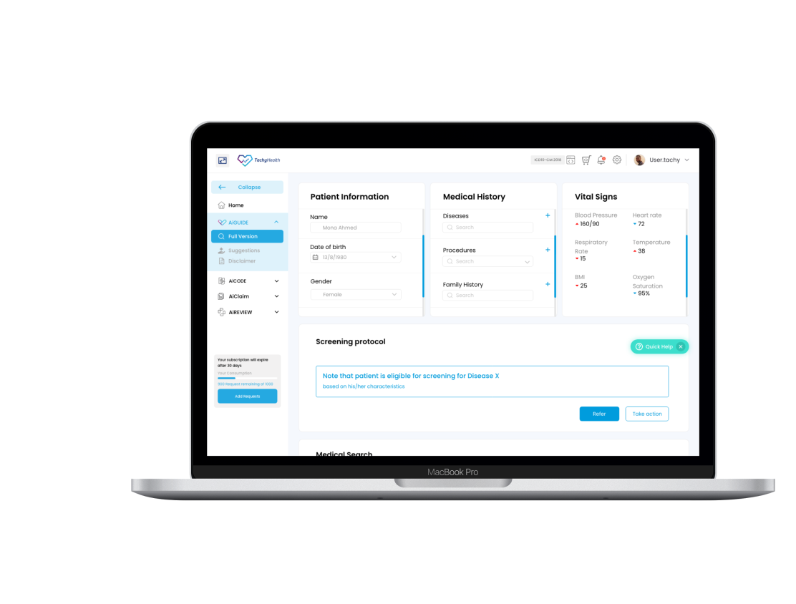
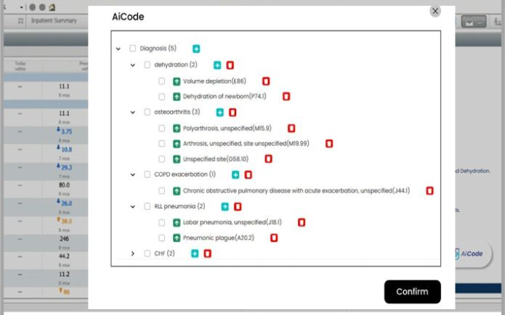



An Artificial Intelligence assisted medical coding solution that increases the productivity as well as the accuracy of medical coding functions.
Improved Medical Coders Productivity
Eliminated Errors in the Service Mapping
Increased Accuracy in the Coding of OP & IP
Supported by

Slide 7
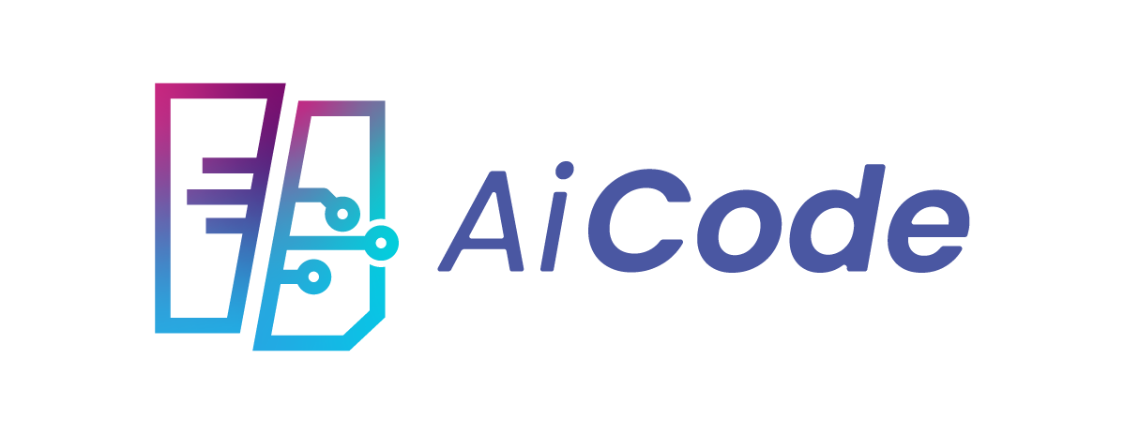




Encounter – Post Encounter
Our complete solution for accurate, efficient medical coding in the digital age
Entry
Process
Outcome
Impact
- Processes PDFs, Word files, and images.
- Converts handwritten documents accurately.
- Extracts medical keywords and suggests codes.
- Ensures alignment with relevant standards.
- NLP analyzes the record
-Medical Keywords extracted
-Medical notes converts to codes
- Diagnosis codes
- Procedure codes
- Medication codes
- Compliant documentation
- Ready for billing systems
- Reduces coding time significantly
- Minimizes human error
- Improves revenue cycle
- Increases coding accuracy
-Reduce rejection rates
Powered by

Slide 8





1. AI assisted coding
2. AR-DRG
Grouper
3. Service Mapping Tool
4. Code Search
A search experience akin to Google's, employing advanced indexing algorithms tailored for medical codes encompassing ICD10AM/ACHI/ACS/SBS
Utilizing NLP, it converts various clinical notes and lab results, into corresponding ICD-10 AM and SBS codes.
Utilizes licensed Australian data to calculate corresponding DRGs for inpatients.
Utilizes licensed Australian data to calculate corresponding DRGs for inpatients.
Supported by

Slide 9

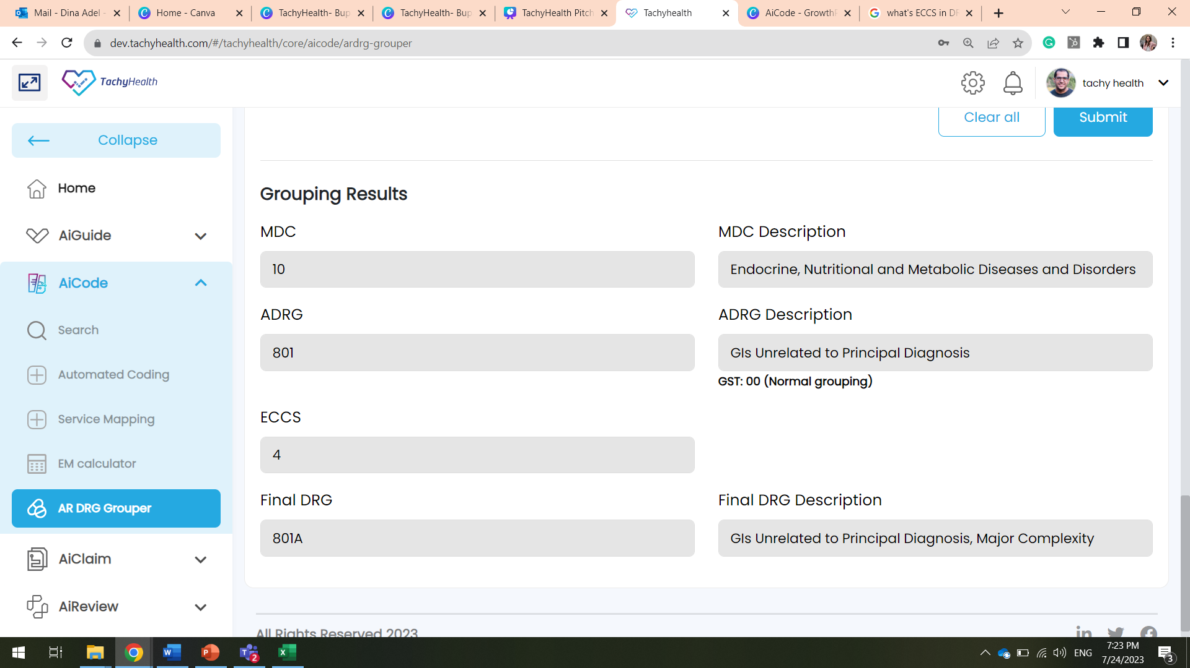
AiCode offers AR-DRG Grouper for optimized coding process
Give instant results with
MDC & DRG & ECCS Score
AI in AR-DRG Grouper boosts accuracy, speeds up reimbursement, and improves decision-making, optimizing resource allocation and patient outcomes .
Some of the results given through AI-model:
MDC (Major Diagnostic Category)
ADRG(Adjacent Diagnosis Related Groups)
ECCS (Episode Clinical Complexity Score)
Final DRG, DRG description
9

Slide 10









AiCode Bonus Perks
Seamless Integration
Supports Compliance
Interactive Control Panel
Easy to use
AI Model accept all file formats
Continous Learning
Improves Efficiency & Accuracy
Advanced E & M calculator
Powered by

Slide 11




















Large scale partnerships
We are proudly working with some of the best healthcare clients in MENA
Integrations In-Progress
Following the regulations of
Empowered and supported by
Research and academic partners
Private and Highly Confidential
Notes:
Add GIG
Add Iqvia
Add IA instead of SAMA

Slide 12






Empowering Healthcare Worldwide:
TachyHealth’s Strategic Global Hubs
Riyadh, KSA
Abu Dhabi, UAE
Delaware, USA
Dubai, UAE
TachyHealth LLC is located in Riyadh, KSA Registered in MISA
Business license
#102104211106610
TGM HOLDINGS LIMITED
DD-15-134-004 - 007, Level 15, Wework Hub71, Al Khatem Tower,
Abu Dhabi Global Market Square, Al Maryah Island,
Abu Dhabi, United Arab Emirates
TachyHealth, Inc Delaware 16192 Coastal
Highway
Lewes, DE 19958
Business license
#7076408
TachyHealth is located at In5-Tech in Dubai Internet City
Business license FZ-
LLC #96474
12

Slide 13






For further information, contact us.
info@TachyHealth.com
www.TachyHealth.com

